Slide 1
Tarea Evaluación
Módulo 17
Jose Miguel Gutierrez
Jose Luis Mba Bechiro
Ignacio Sedano Fiñana

Slide 2
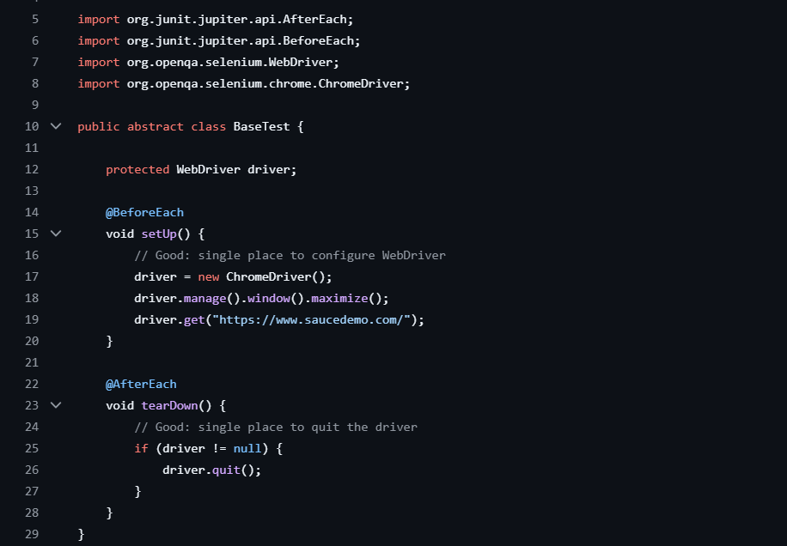
After BASE TEST
This class is responsible for setting up and tearing down the WebDriver for every test. It uses @BeforeEach to open a Chrome browser, maximize it, and navigate to the test URL, and @AfterEach to quit the driver. While this avoids duplication, it is still very basic: it hardcodes the browser and URL, has no configuration system, and doesn’t include waits or environment flexibility. This makes it less scalable and harder to maintain in real-world projects.

Slide 3
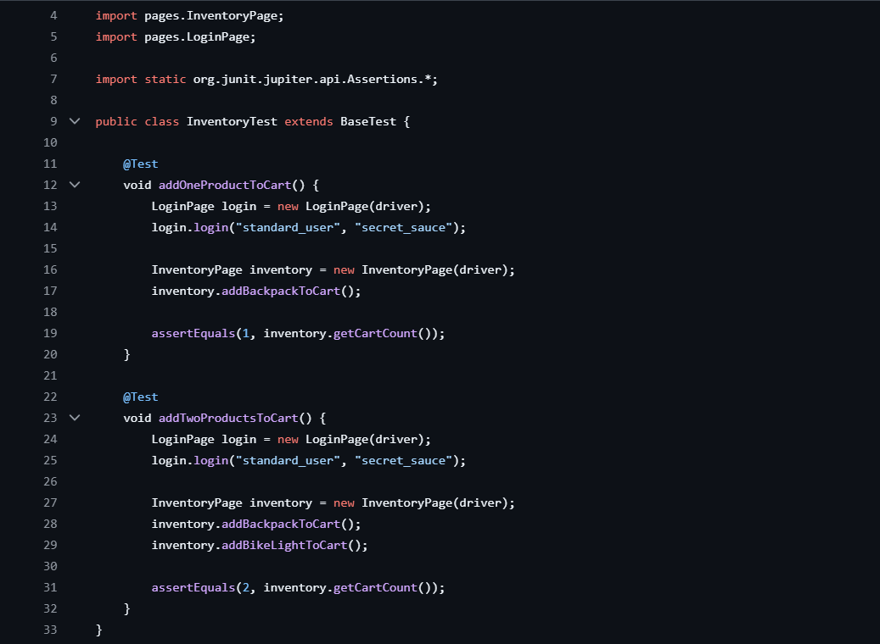
After INVENTORY TEST
This class contains tests for adding products to the cart. Each test logs in, creates page objects, performs actions, and asserts the cart count. The main issue is repetition: the login logic is duplicated in every test, which violates the DRY principle. Test data (username and password) is hardcoded, making it inflexible. Also, the assertions are simple and there are no waits, which could make tests flaky. Overall, the structure works but is not optimized for maintainability or scalability.

Slide 4
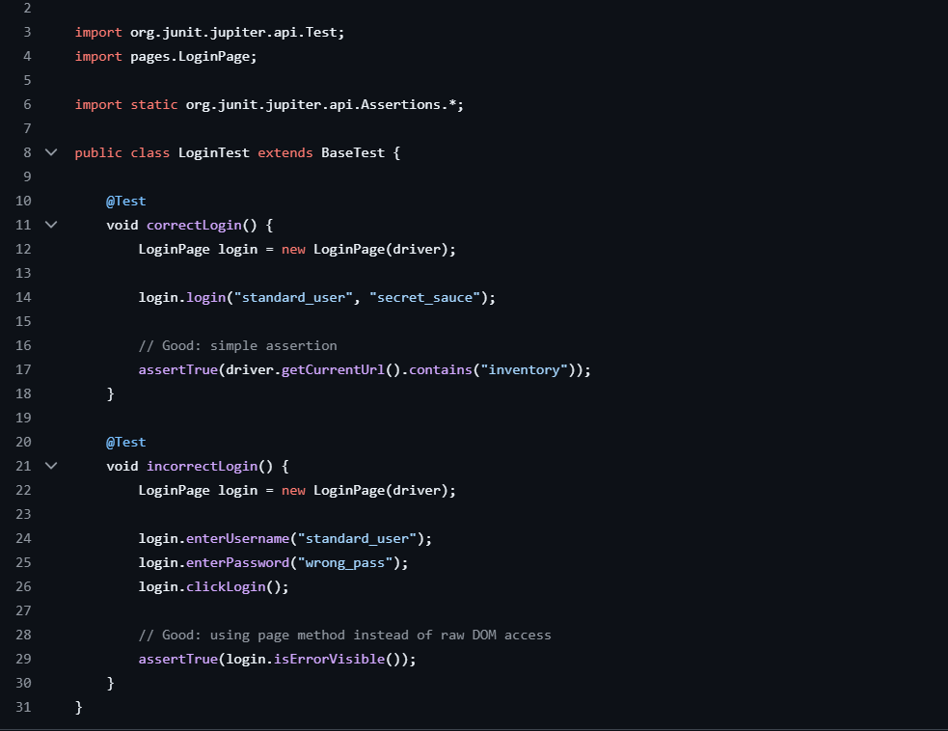
After LOGIN TEST
This class tests login functionality with valid and invalid credentials. It follows the same pattern: create a page object, perform actions, and assert results. The positive test checks if the URL contains a string, which is a weak assertion because it doesn’t guarantee the page is fully loaded. The negative test is better because it checks for an error message via a page method. However, it still suffers from hardcoded data, no waits, and repeated setup logic.

Slide 5
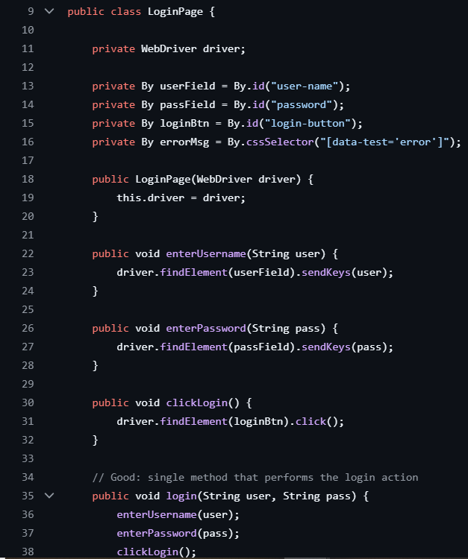
After LOGIN PAGE
This class models the login page and is better structured. It defines locators as variables, which improves maintainability. It provides methods to interact with elements and a combined login() method for convenience. This is cleaner and follows good POM practices. Still, it has some problems: no waits are used, so interactions may fail if elements are not ready; the login() method hides steps, which reduces flexibility in some test scenarios; and there’s no method to verify that the page is loaded. Like before, it depends directly on WebDriver, making it tightly coupled and less scalable

Slide 6
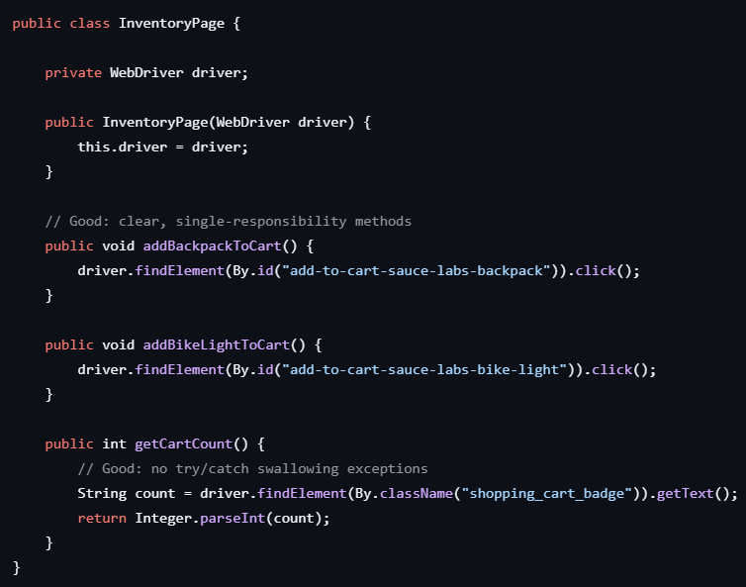
After INVENTORY PAGE
This class represents the inventory page using the Page Object Model. It receives a WebDriver and provides simple methods like addBackpackToCart(), addBikeLightToCart(), and getCartCount(). The good part is that methods are small and focused, which improves readability. However, there are still issues: locators are used directly inside methods instead of being stored as variables, there are no waits , and getCartCount() assumes the element is always present. Also, there’s no validation that the page is actually loaded before interacting with it

Slide 7
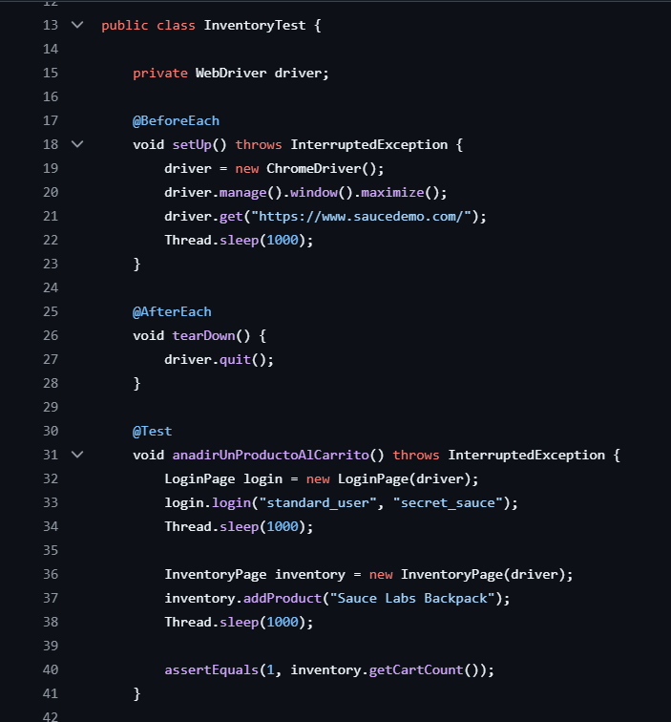
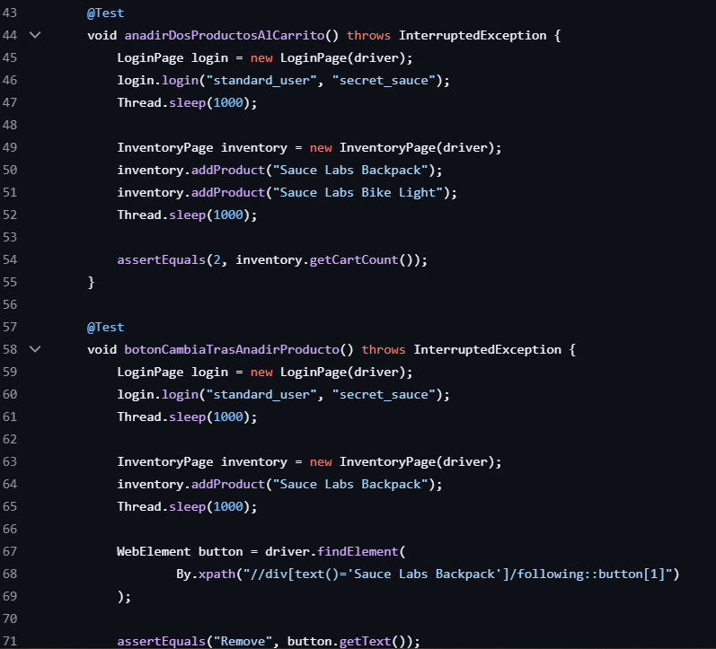
BEFORE INVENTORY TEST
The new version replaces duplicated setup and Thread.sleep() with a shared BaseTest class using @BeforeEach and @AfterEach. This centralizes WebDriver management, removes repetition, and makes tests cleaner and more maintainable

Slide 8
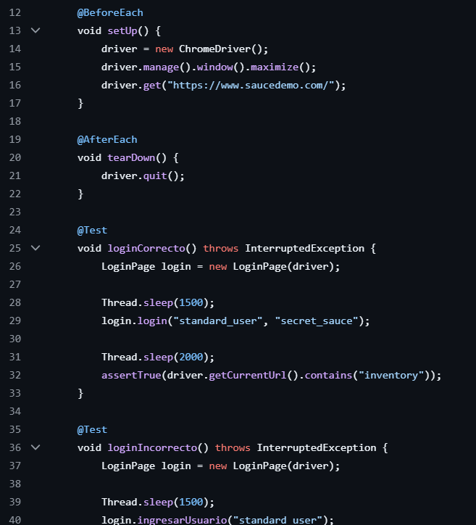
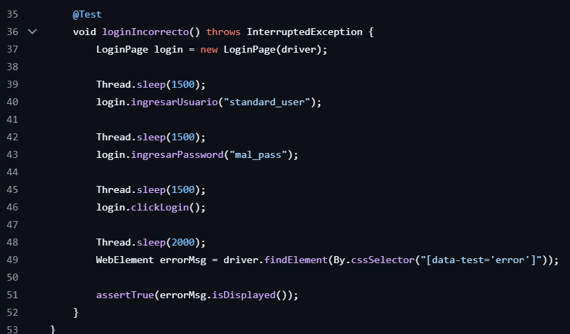
BEFORE LOGIN TEST
The refactored version removes Thread.sleep(), avoids direct WebDriver usage in tests, and uses the Page Object (LoginPage) for all actions and validations. This makes the tests cleaner, less fragile, and easier to maintain.

